Slide 1
CAR Calibration Meeting CAR Review
AP Team
Catherine Qiu, Kawano Motomu, Samantha Bang and Simy Li
December 10, 2013

Slide 2
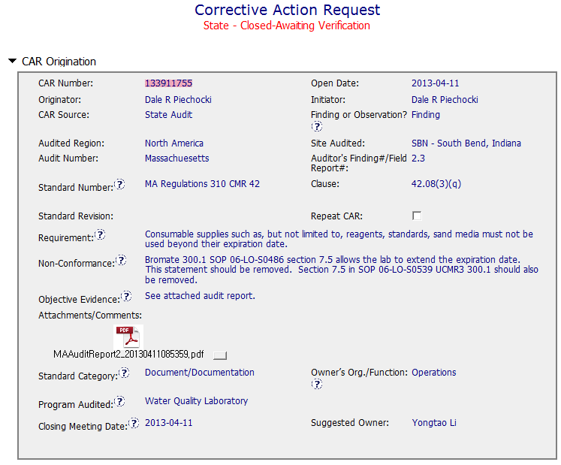
CAR# 133911755
Finding
Expiration date of Consumable supplies
SOP allows the lab to extend it
→Document/Documentation
Clear description of non-compliance
Not clearly indicate
the objective evidence
Collaboration (L) : Objective evidence are attached as needed. But, To be improved to indicate the objective evidence clearly.

Slide 3
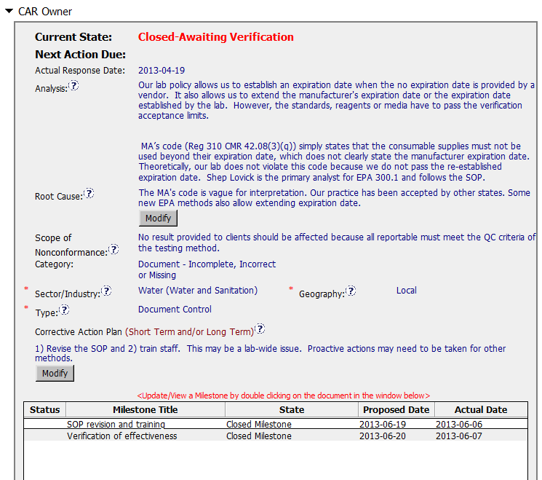
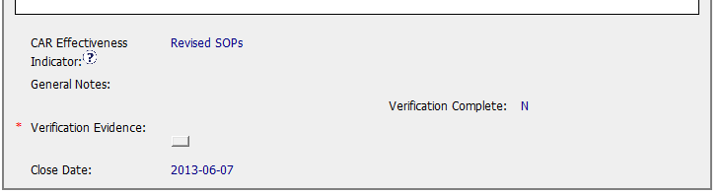
CAR# 133911755
More analysis is needed to determine why this problem occurred
To be improved by getting the succinct and reasonable root cause
“Containment” has not been documented
The corrective action managing the root cause has not been addressed.
“Verification” to confirm the effectiveness of corrective action plan has not been documented
It is helpful to include
the word “Containment” as a part of the milestone title to clearly indicate that containment has been addressed.
[Collaboration] (C L) – To be improved by working with CAR Owner to get the reasonable Root Cause and CA Plan.

Slide 4
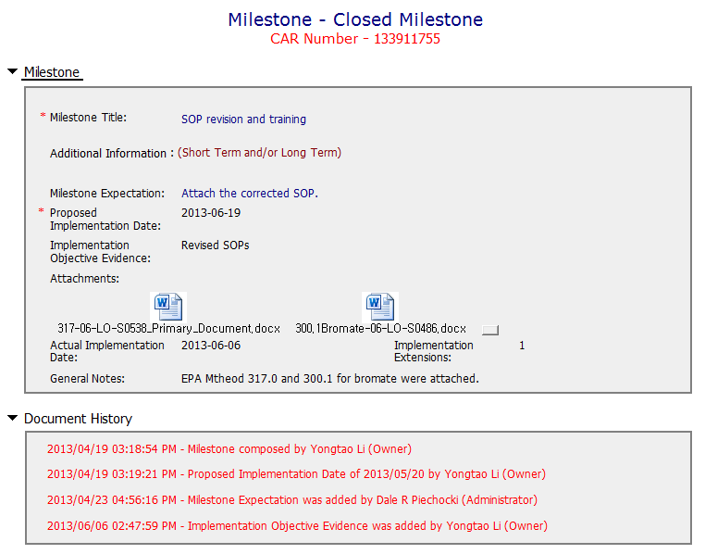
CAR# 133911755
Need to address containment
[Competitiveness] (C) - To be improved by addressing containment

Slide 5
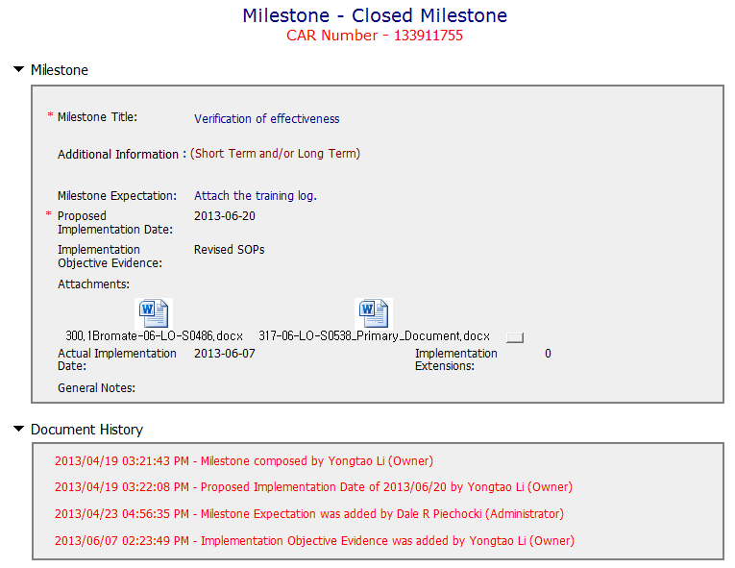
CAR# 133911755
Need to address Milestone expectation
[Competitiveness] (C) - To be improved by engaging with CAR Owner to complete milestone as per expectation.

Slide 6
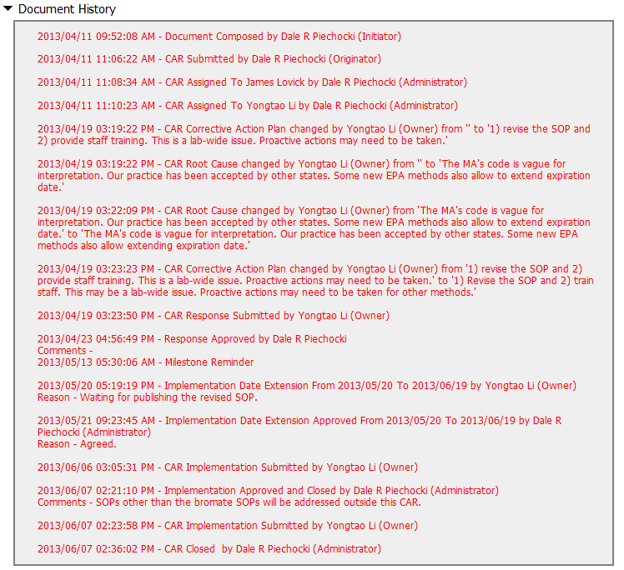
CAR# 133911755
The number of extensions is still meeting the requirement.
[Integrity] (C) – No extension is over 30 days or more than 3 times

Slide 7
CAR# 133911755 (Overall Comment)
As analysis is not enough and a root cause needs to be more reasonable.
Corrective action plan needs to be developed based on the root cause identified.
Some actions have not been conducted as planned.
Notes:
Milestones – have final milestone for owner’s verification of effectiveness; enough time is allowed for new records to be examined
Although CAR owner self-verification is added at the last milestone, it doesn’t cover the corrective action for the failure conducting previous Management Review.
In fact, would the next round of Management Review be able to conducted on-time, it has not been addressed.
It is suggested that the verification should focus on whether the updated process and/or next round of Management Review is in place to avoid recurrence of such nonconformity.
Milestones – completed per milestone expectations
It is acceptable as Containment Action for the supporting evidence covered in the 1st milestone, i.e. Management Review Report for Year 2011 and Year 2012 [Suggest to inviting a person could read German for verification…].
However, the evidence “Attachment of the management review 2013 in milestone one. The effectiveness of the management review was reviewed by the EULA Region Quality Manager and found to be acceptable.” stated in the 2nd milestone is irrelevant while the Management Review for Year 2013 has not been conducted yet. Not sure how CAR Administrator accepts it.
In addition, for 2nd milestone, it is suggested that a statement should be provided by CAR Owner to indicate that “Recommendation for improvement” is now covered as input in the process of Management Review for Year 2011 and 2012...

Slide 8
CAR Review
Team B:
Matthew Marotto, Rebeca Navarrete, Jim Kurtz

Slide 9
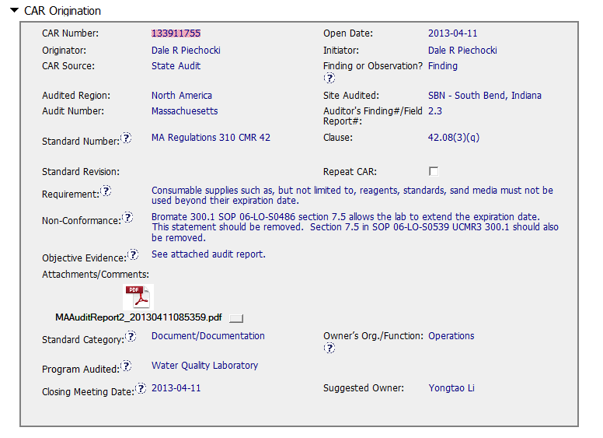
CAR 133911755
Correct Audit number?
Standard Revision?
Suggest placing OE in body of CAR, rather than referring to a report.
Not clear why non-conformance statement “Section 7.5 in SOP 06-LO-S0539 UCMR3 300.1 should also be removed.” How does the non-conformance relate to the requirement?

Slide 10
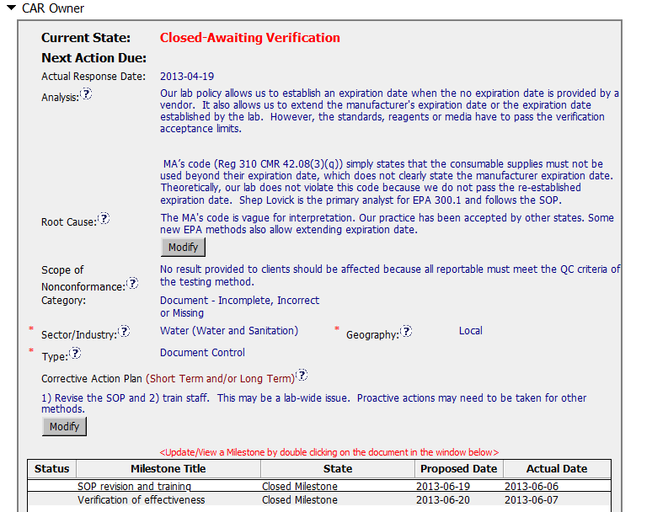
CAR 133911755
Analysis is going around the requirement. Re-establishment of the expiration date is to go beyond to the expiration date and against the rule.
What did we do to try and improve the wording in the requirements, appears that RC is suggesting that there is no basis for finding in analysis.
No root cause established
Process implementation or deployment
No scope of non-conformance
Testing (Internal UL)
No containment nor rationale to do not implement it
CAP states this may be a LAB wide issue what was done to determine if it was or not?

Slide 11
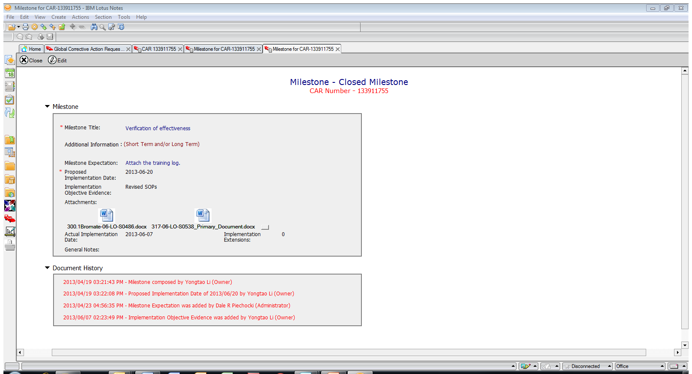
CAR 133911755
Verification – no training log attached, should not have been accepted.

